Slide 1
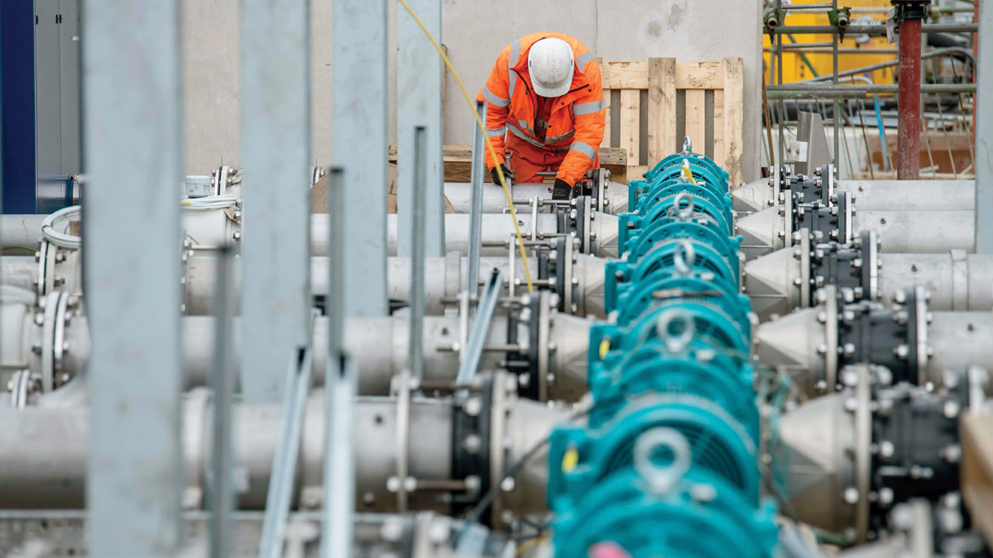
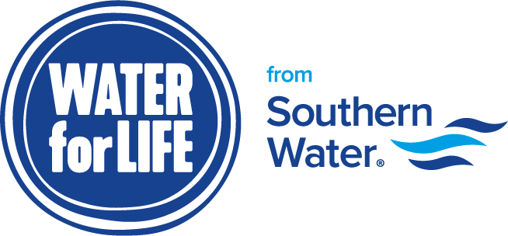
Southern Water Corp Financial Analysis
Presented by Nicole Naylor
Springboard
July 28th, 2024

Slide 2
EBIT Value Driver Tree
001 Private Water Hedge Sales
W-Transact (0211) - Soft
W-Transact (0212) - Hard
Revenue
+
002 Public Sales
W-Transact (0211) - Soft
W-Transact (0212) - Hard
003 Residential Sales
W-Transact (0211) - Soft
EBIT
-
Chemical Costs
Chem-Exp (001)
Utility-Exp (002) - Heating
Facility Costs
Utility-Exp (002) - Electricity
Plant Maintenance (001)
Operating Expenses
+
Operational Maintenance Costs
Plant Outages (002)
Plant Op. Costs (003)
Cost Centre
Plant Admin Costs (004)
Labour Costs
Labour-Costs (001)
Profit Centre

Slide 3
Although demand for private water sales is soaring ($187.4M), expenses are still quite high, especially for chemical ($78.4M) and labor ($87.3M) costs. Surjek is currently the least profitable unit (11.3%), and Jutik is the most profitable (44.6%).

Slide 4
Surjek’s private water hedge sales consistently bring in the most income ($82.4M), followed by Surjek’s public sales ($70.6M) and Jutik’s private water hedge sales ($67.9M). Kootha is Water Corps’ lowest earner, especially in residential sales ($15.6M).

Slide 5
It is evident that there is a “slow period” of sorts between October and December, when sales drop. This is seen across the board. However, sales begin to spike between the months of January and February.

Slide 6
Private sales bring in the most revenue altogether, ranging between 40 and 55% of sales in each unit. Residential sales are doing poorly, reaching no more than 25% of sales in each unit. Focus should be placed more on private and public sales, as they are most popular and profitable.

Slide 7
The majority of expenses go to chemical costs and labor costs each month. Surprisingly, labor costs hit nearly $18.7M in the month of November 2013, when sales were at its lowest for most units. A reduction in labor costs should be implemented, especially in the winter months.

Slide 8
While Surjek brings in the most revenue, it also has the highest chemical expenses out of the units. Surjek is spending anywhere between $2.2M and $5.4M on chemical expenses per month, while Jutik’s expenses are at $2.6M and Kootha’s are at $1.1M at a maximum. In November 2013, there was only about a $30 difference between Surjek’s and Jutik’s water production, though Surjek had over double ($4.5M) the chemical expenses that Jutik had ($1.3M).

Slide 9
Surjek’s chemical costs ($45.3M) are more than double the costs for other units ($10.1M and $22M respectively). Surjek also seems to have much higher costs for plant outages and maintenance. With an update to Surjek’s plants, the costs for outages and maintenance would lower. A change also needs to be made with Surjek’s chemical expenses. Jutik's labor costs are nearly 35% of their expenses, so lowering the labor costs for Jutik may also be a good idea.

Slide 10
After comparing revenues and expenses, it is clear that Surjek is not as profitable as it should be. In the months of November 2013 and May 2014 alone, Surjek has lost Southern Water Corp $10.5M. It turns out that Jutik is Southern Water Corp’s most profitable unit, nearing $73M in profits. Kootha and Surjek combined only bring in little more than two thirds of Jutik’s income after expenses ($42.6M).

Slide 11
Kootha’s profitability has decreased significantly since March of 2014. Jutik has consistently retained about 45% of their profits between July 2013 and June 2014. Surjek’s profitability is incredibly inconsistent, though it has lost nearly 45% of profits in one month due to high expenses. Overall, Jutik is more profitable (44.6%) than both Kootha and Surjek combined (39.1%).

Slide 12
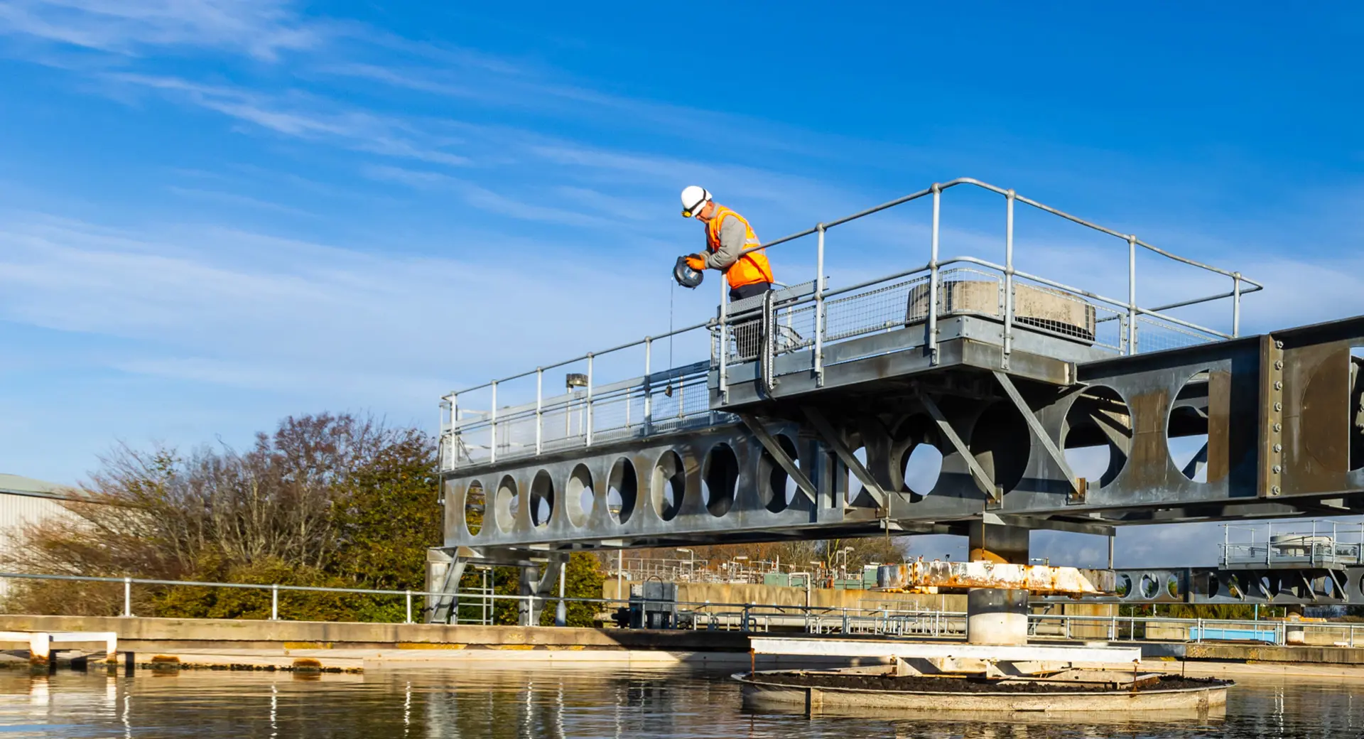
Summary
Focus on private and public water sales rather than residential
Lower labor costs, especially in the winter months when customer demand is at its lowest
Lower Jutik's labor costs
Lower chemical costs, primarily for Surjek
Update Surjek’s facilities to lower plant maintenance and outage costs

